Slide 1
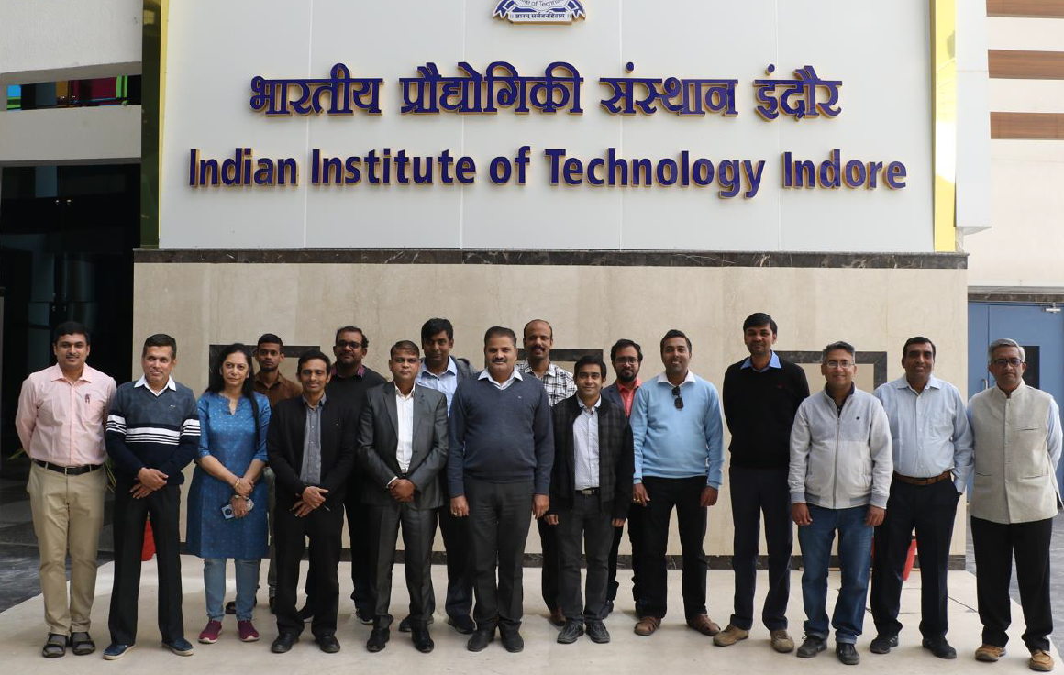
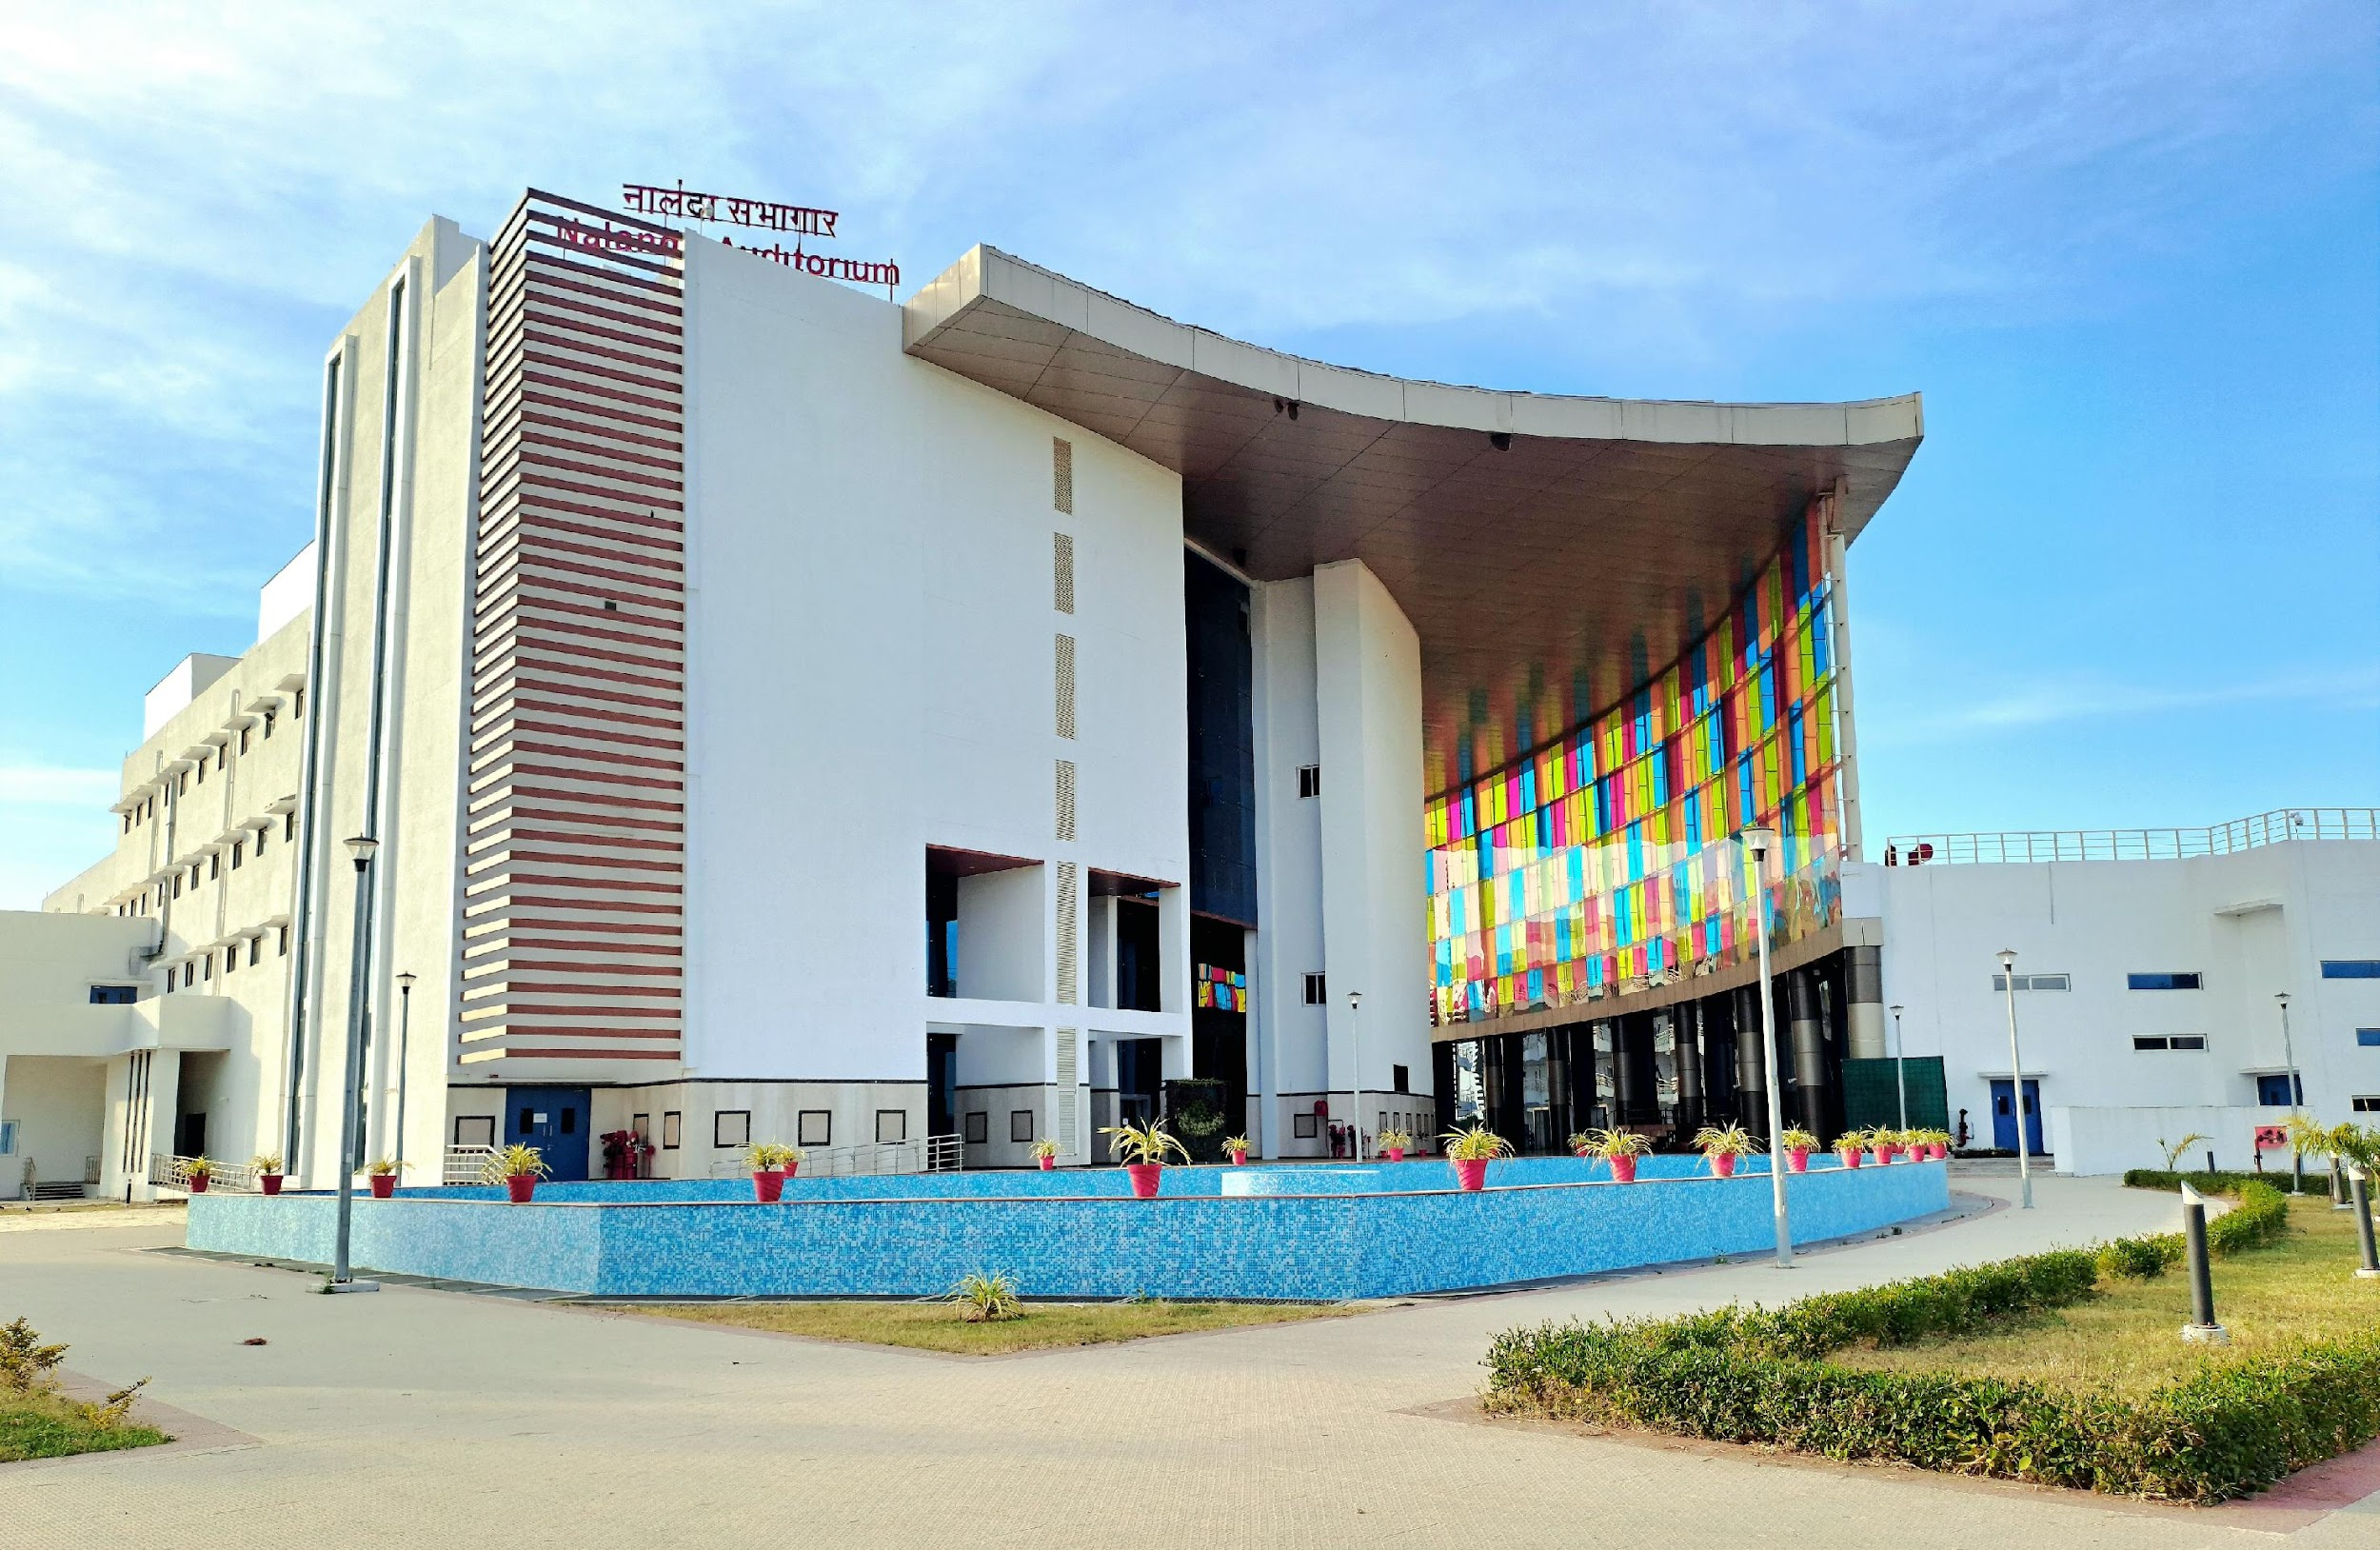

Welcome to the Department of Electrical Engineering
IIT INDORE
The Faculty Team
Nalanda Auditorium

Slide 2
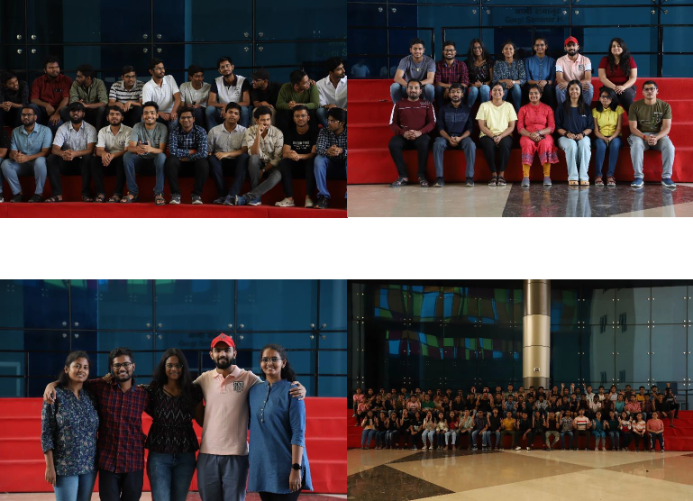
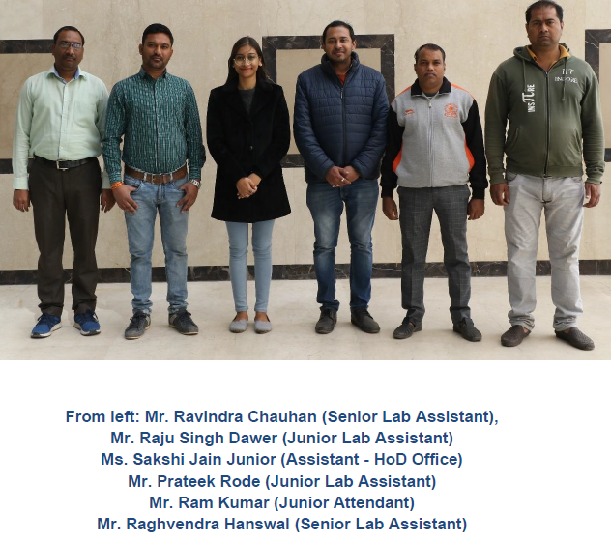
The Department Staff Team
UG & PG students
Department of Electrical Engineering IIT INDORE

Slide 3
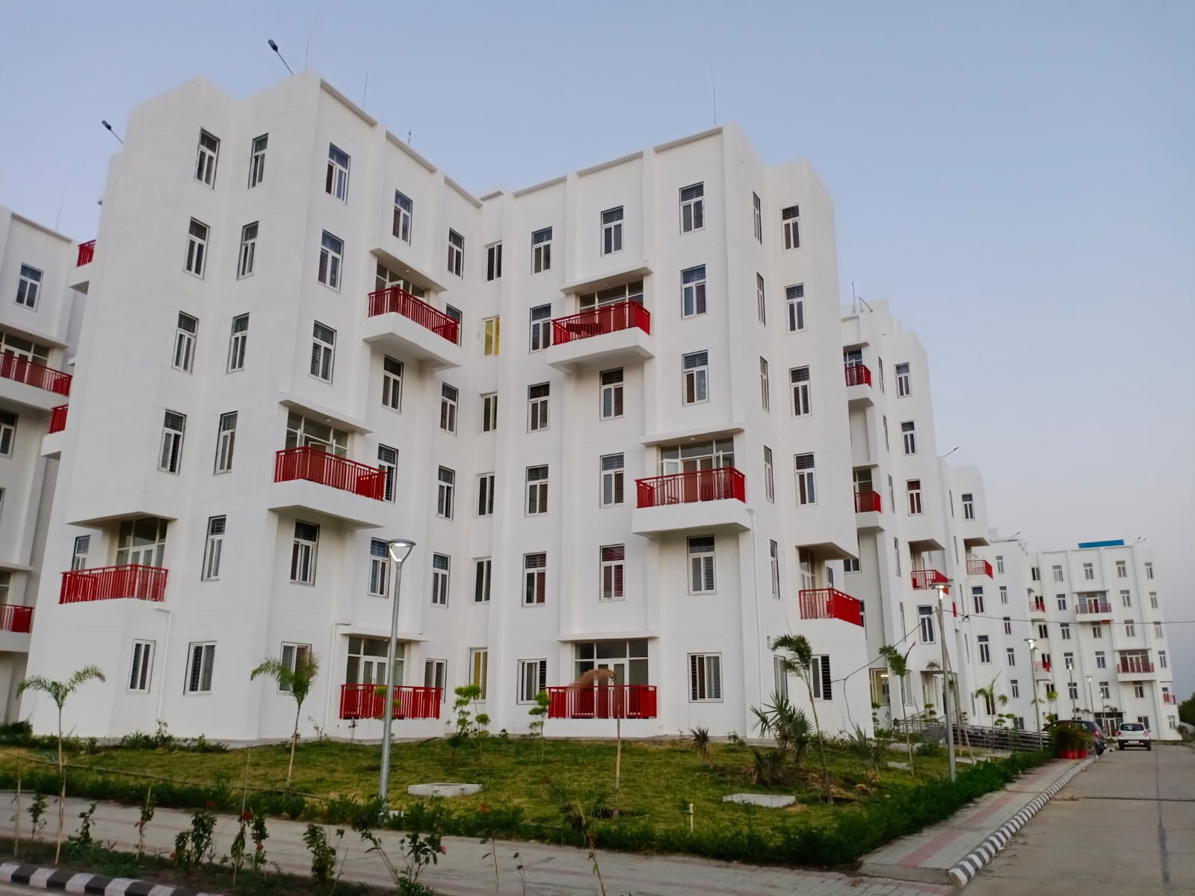
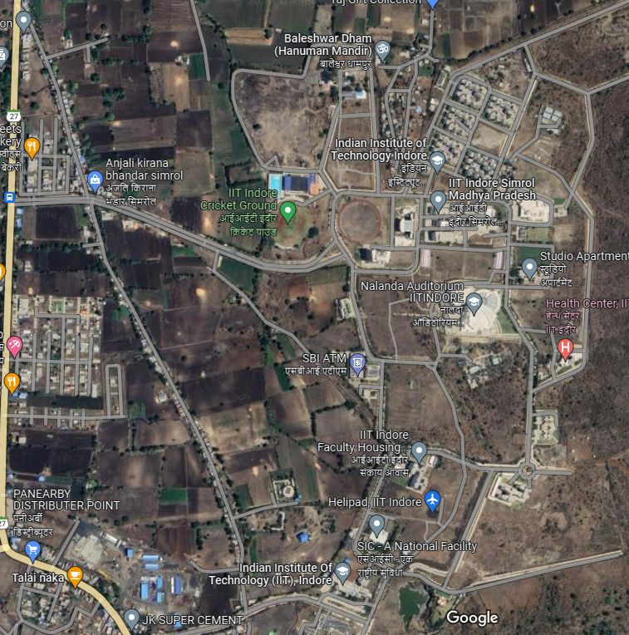
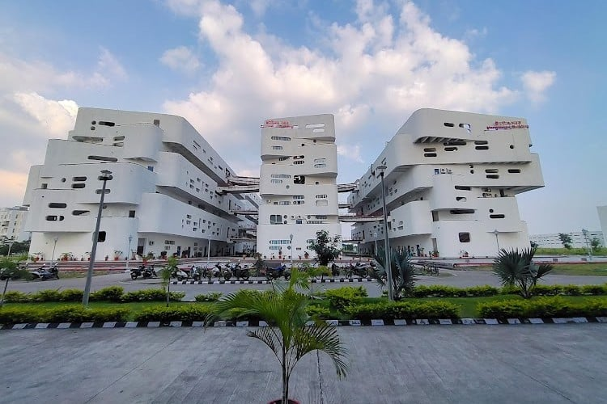
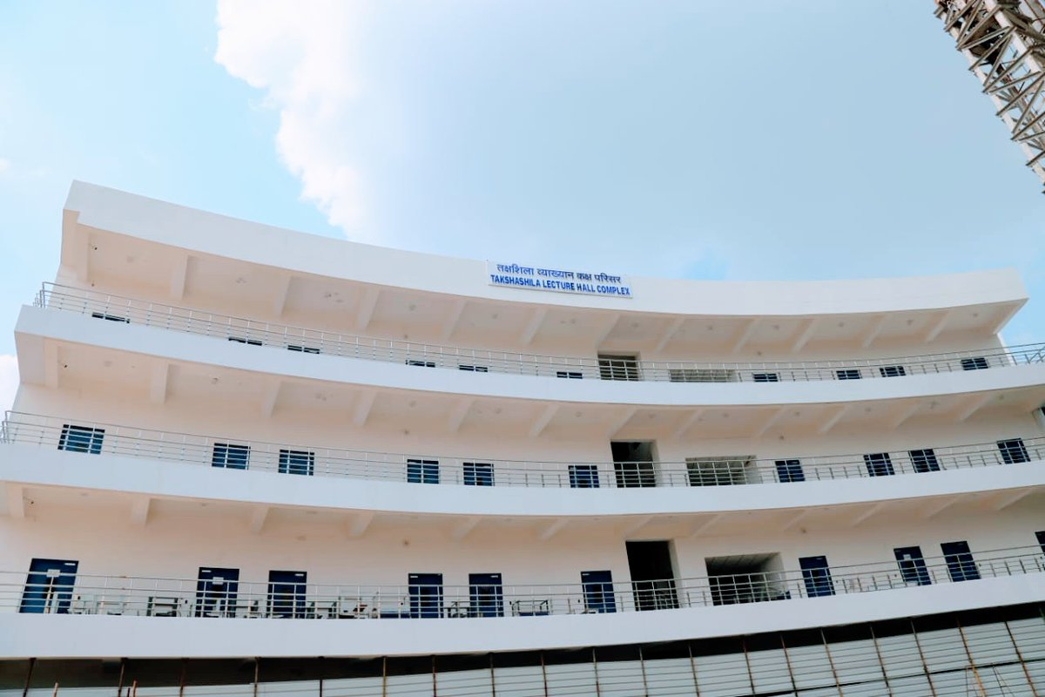
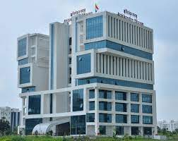

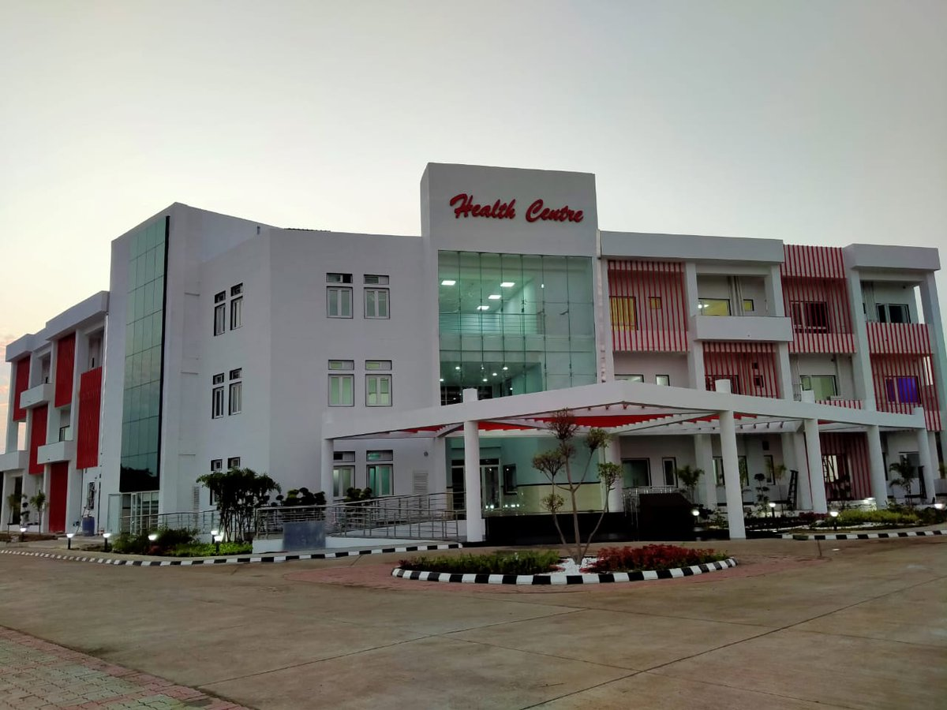
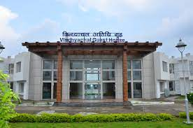
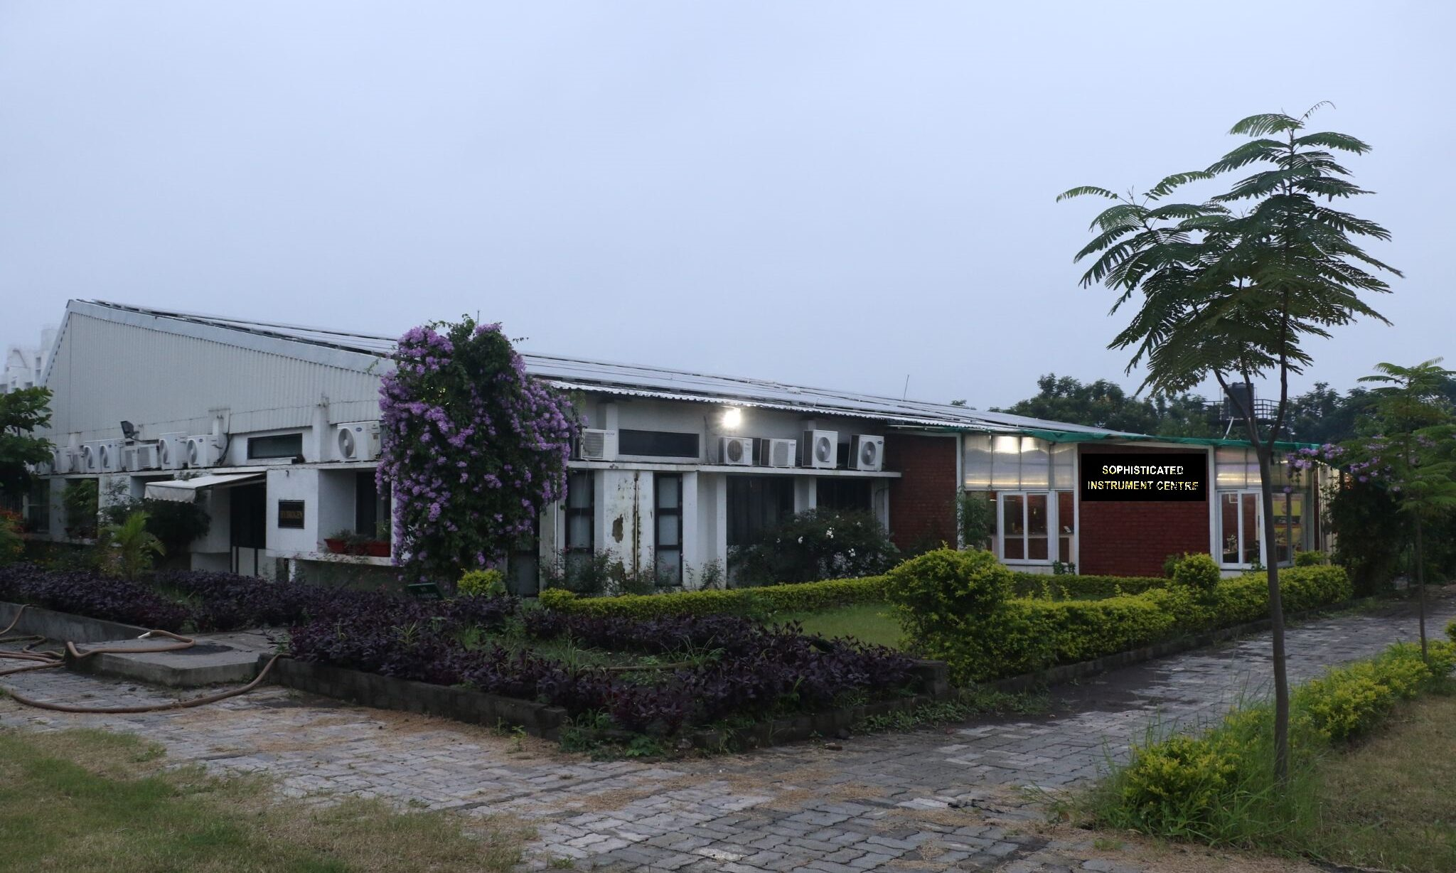
Hostels
Main GATE 1
Academic Buildings (Pods 1)
EE: Mainly Pod 1 A – Silicon Building
Library and Abhinandan
Building
Takshashila Lecture hall complex
Nalanda Auditorium
Health Center
Vindyachal Guest House
Main GATE 2
501.42 acres
The Campus
Sophisticated Instrumentation Center

Slide 4
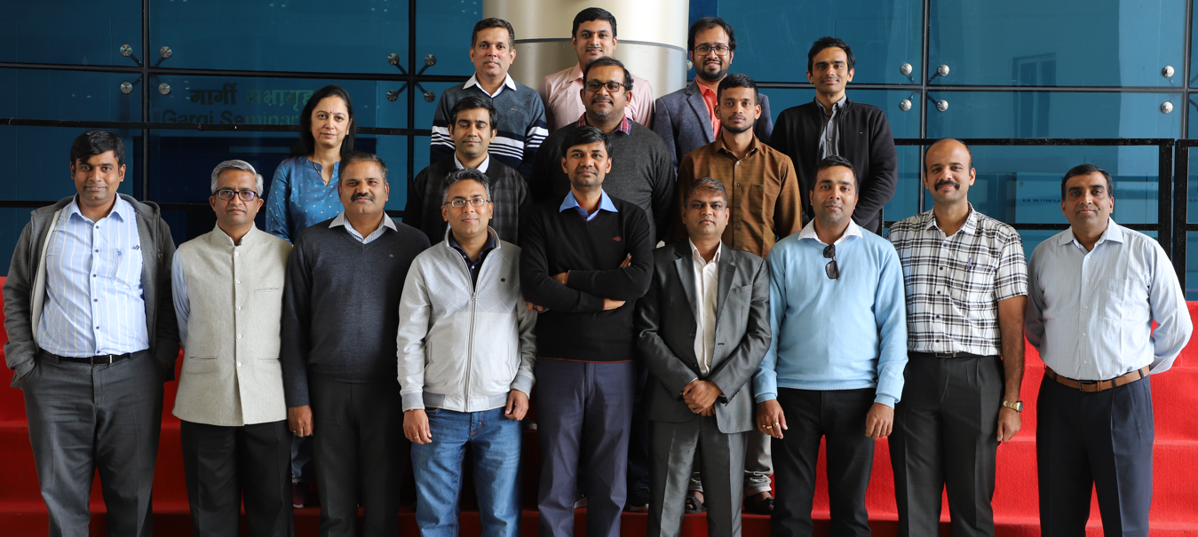
The Department
The Department of Electrical Engineering at IIT Indore, established in 2009, is one of the founding departments of the Institute.
The department currently has 19 faculty members having excellent academic credentials.
The department is actively engaged in following research areas:
Communications
Image & Signal Processing
VLSI, Nanoelectronics
Semiconductor Devices
RF and Microwave, Photonics
Biophotonics Instrumentation
Power Systems and Power Electronics
Department of Electrical Engineering IIT INDORE

Slide 5
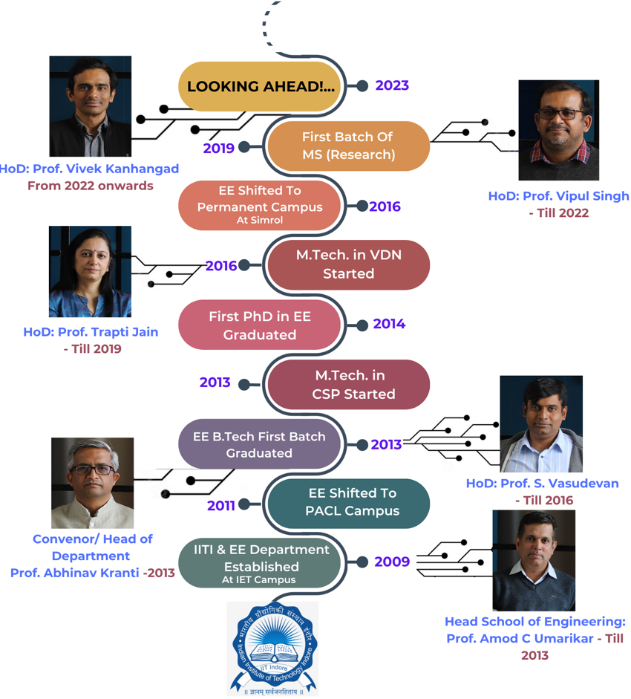
Our History
Department of Electrical Engineering IIT INDORE

Slide 6
Our Vision
Our short to medium term vision is committed to make a significant impact in society through a high value and qualitative research. In support of this goal, we will focus on the following areas in the future:
Next-generation Communication Systems, Smart Antennas, and Human-Centered AI for Signal Processing
Flexible Electronics, Semiconductor Nanofabrication, Electronics-Photonics convergence, Energy efficient systems
Renewable Energy Integration and Smart Grid, Cyber-security aspects, System on Chip Biomedical Devices for diagnostics and therapy
Upon enhancing our current strengths, we plan to offer M. Tech. programs in thefollowing specializations:
Power Electronics and Power Systems
RF and Microwave Engineering
Department of Electrical Engineering IIT INDORE

Slide 7
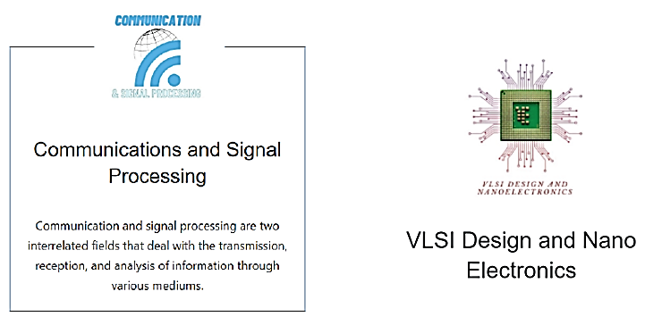
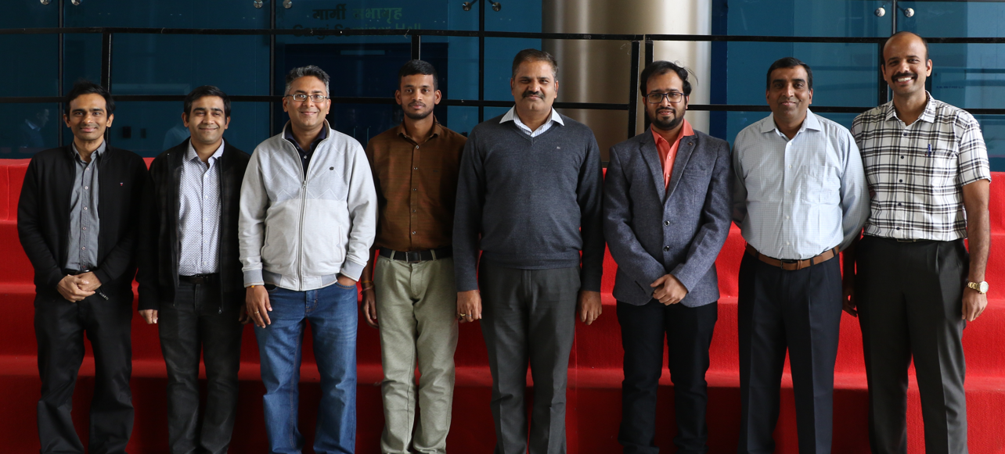
Research Verticals
Communications and Signal Processing
Communication and signal processing are two interrelated fields that deal with the transmission, reception, and analysis of information through various mediums.
Group Faculty members (L to R)
Prof. Vivek Kanhangad
Dr. Saptarshi Ghosh
Prof. Vimal Bhatia
Dr. Appina Balasubramanyam
Prof. Ram Bilas Pachori
Dr. Sumit Gautam
Prof. Prabhat K. Upadhyay
Dr. Swaminathan R.
Faculty members in CSP
Department of Electrical Engineering IIT INDORE

Slide 8
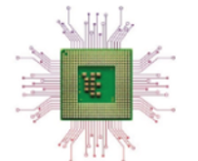
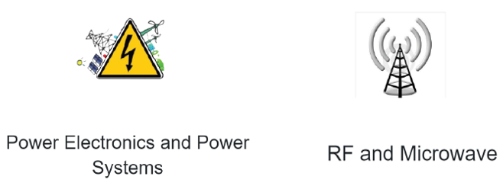
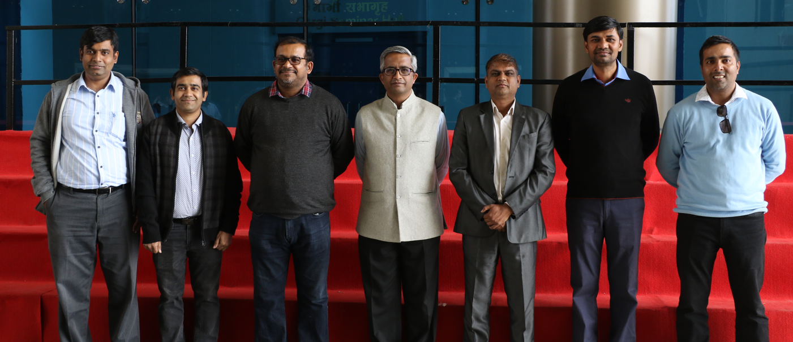
Research Verticals
VLSI Design, Nanoelectronics &
RF and Microwave
Group Faculty members (L to R)
Prof. Srivathsan Vasudevan
Dr. Saptarshi Ghosh
Prof. Vipul Singh
Prof. Abhinav Kranti
Prof. Santosh Kumar Vishvakarma
Prof. Mukesh Kumar
Prof. Shaibal Mukherjee
Dr. Rinkee Chopra
Faculty members in VDN
Department of Electrical Engineering IIT INDORE

Slide 9
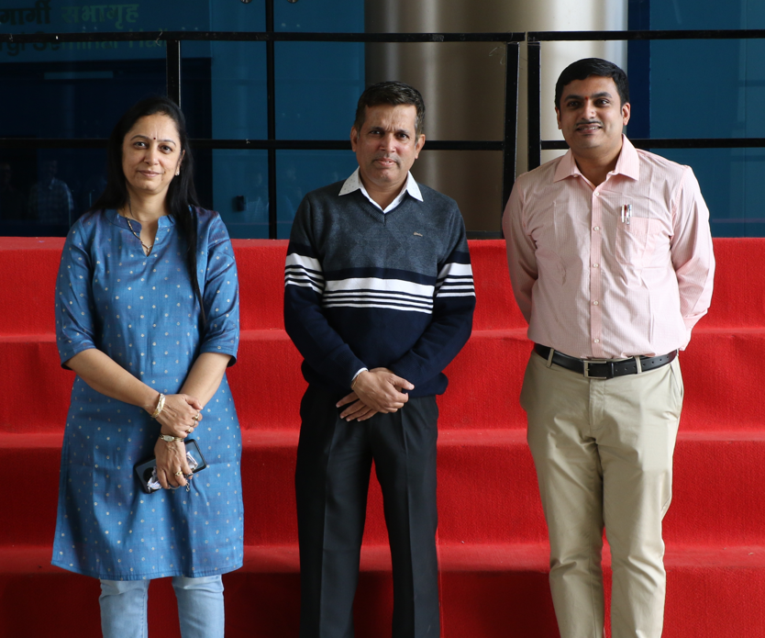
Research Verticals
Group Faculty members (L to R)
Prof. Trapti Jain
Prof. Amod C. Umarikar
Dr. Vijay A. S.
Dr. Subhadeep Paladhi
Faculty members in PEPS
Department of Electrical Engineering IIT INDORE

Slide 10
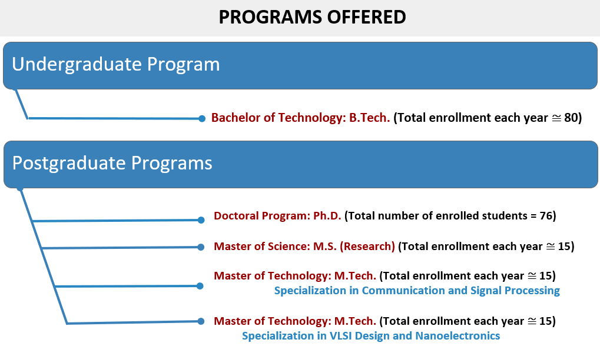
Our Vision
=10)
Department of Electrical Engineering IIT INDORE

Slide 11
Department Statistics
Department of Electrical Engineering IIT INDORE

Slide 12
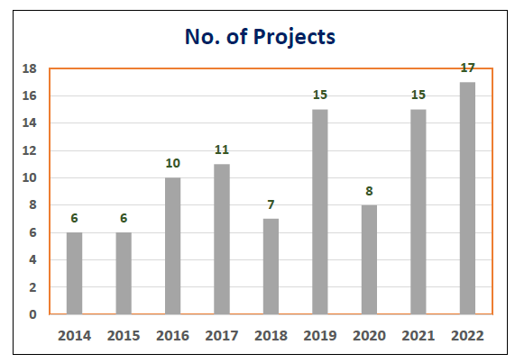
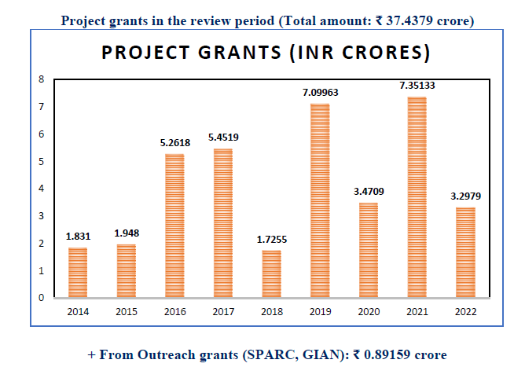
Research Statistics
Department of Electrical Engineering IIT INDORE

Slide 13
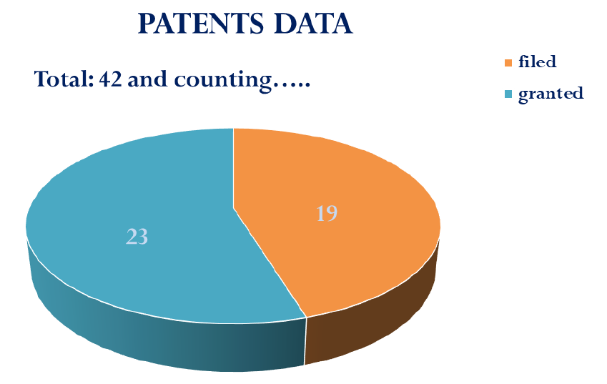
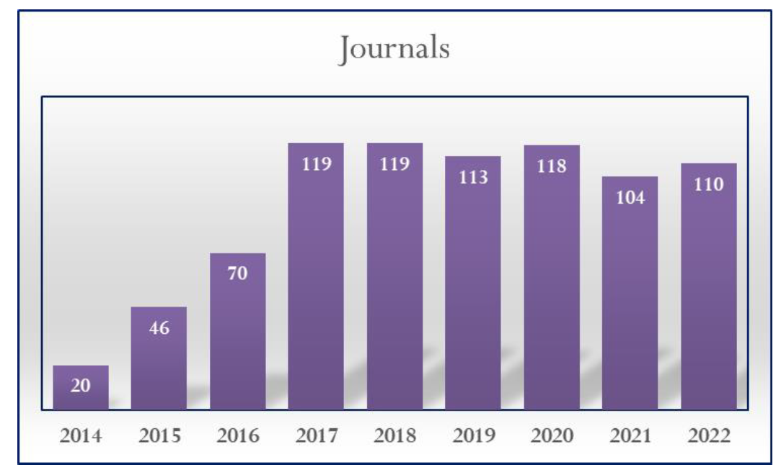
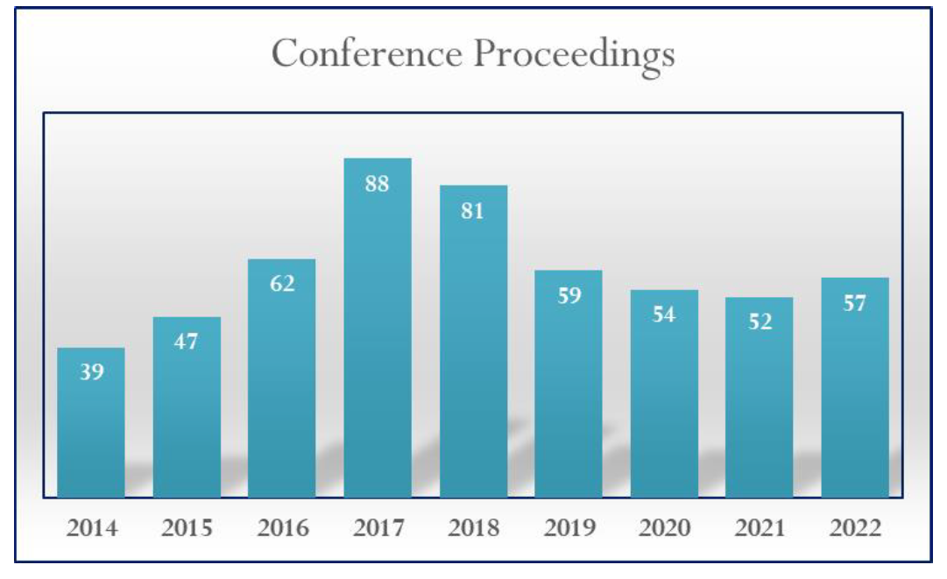
Department of Electrical Engineering IIT INDORE

Slide 14
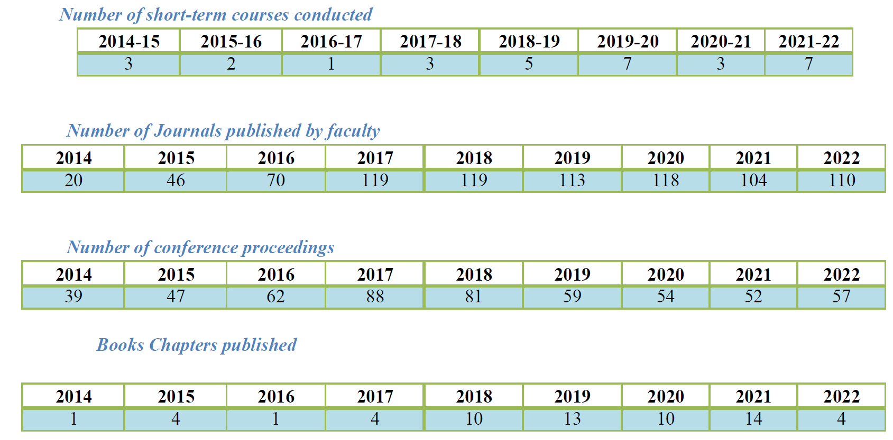
Department of Electrical Engineering IIT INDORE

Slide 15


Slide 16
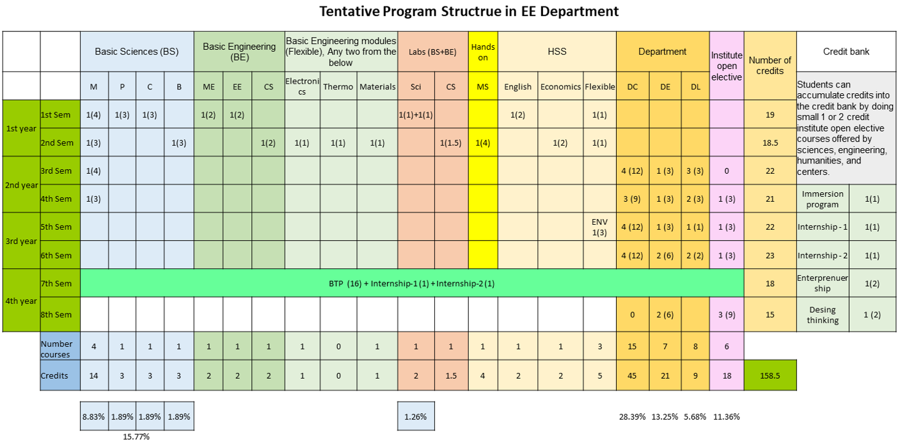
UG Courses
Department of Electrical Engineering IIT INDORE

Slide 17
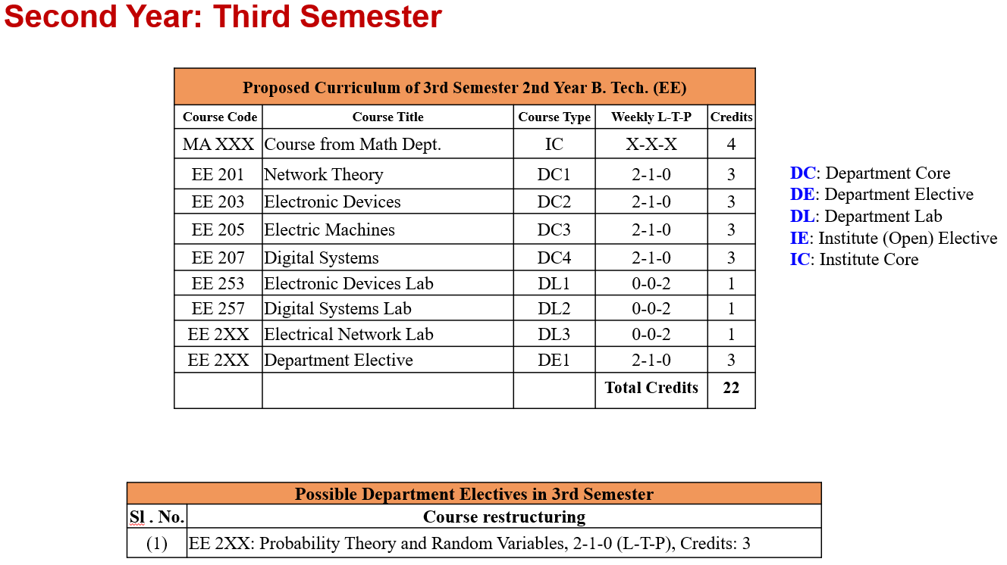
UG Courses
Department of Electrical Engineering IIT INDORE

Slide 18
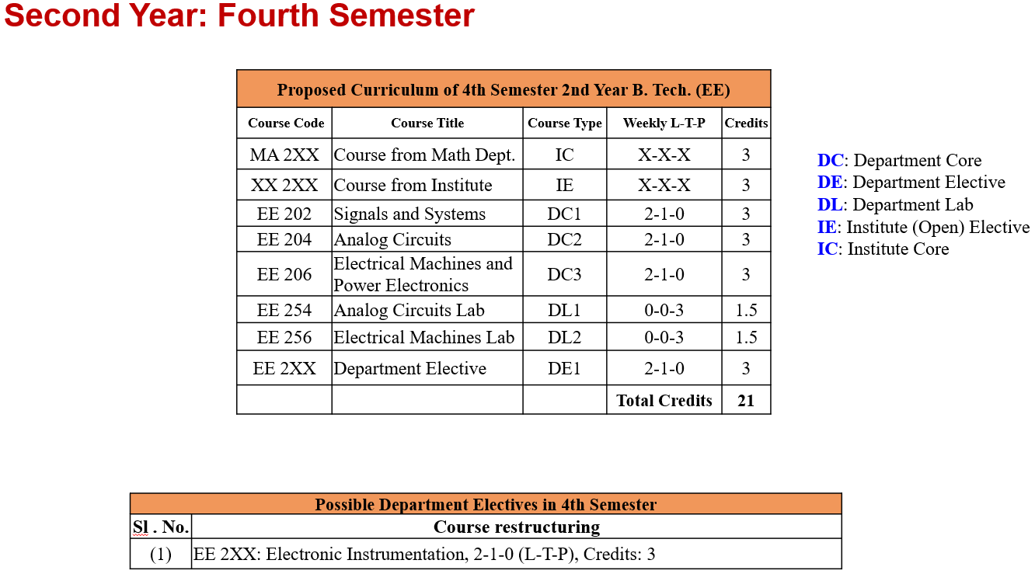
UG Courses
Department of Electrical Engineering IIT INDORE

Slide 19
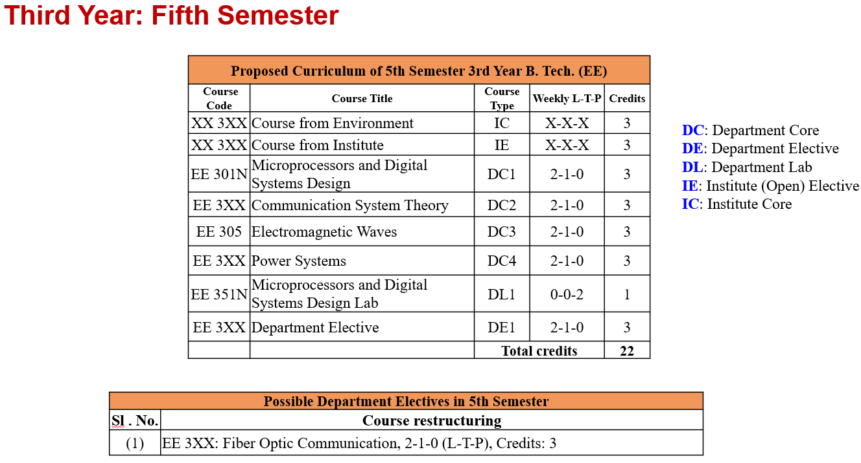
Department of Electrical Engineering IIT INDORE

Slide 20
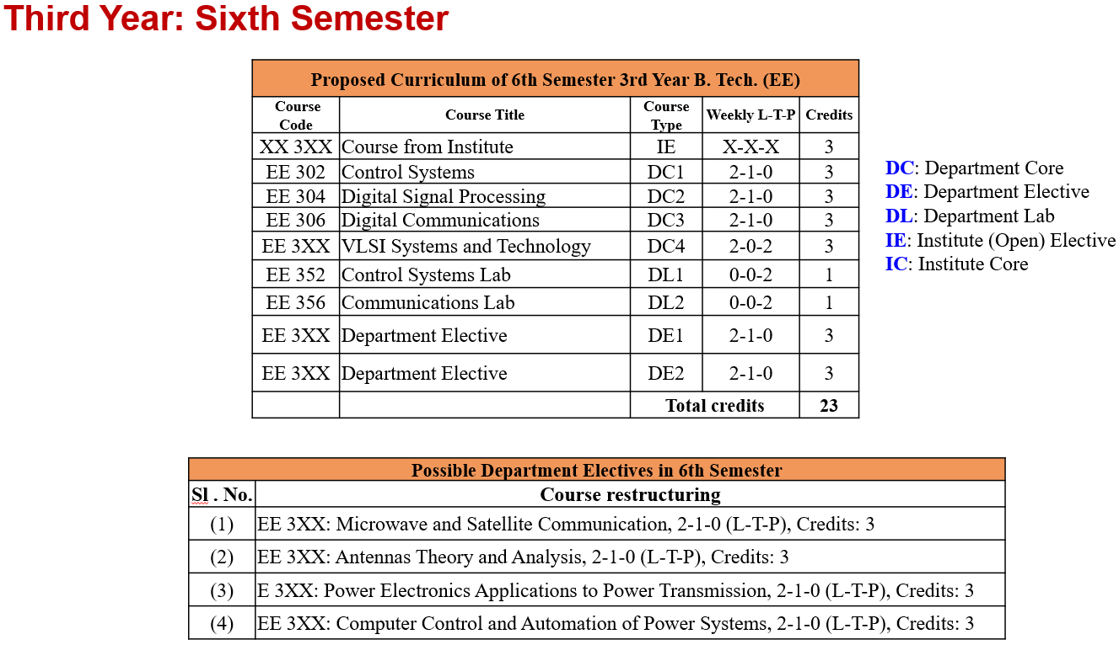
Department of Electrical Engineering IIT INDORE

Slide 21
UG Labs
Basic Electrical and Electronics Lab
Control Systems Laboratory
Electrical Machines and Power Electronics Laboratory
Microprocessors Laboratory
Electronic Devices Laboratory
Analog Circuits Laboratory
Digital Systems Laboratory
Communications Laboratory
Department of Electrical Engineering IIT INDORE

Slide 22
UG Labs
Department of Electrical Engineering IIT INDORE

Slide 23
Research Labs
Sl. No. | Lab Name | Faculty In Charge
1. | Low Power Nanoelectronics Research Laboratory | Prof. Abhinav Kranti
2. | Applied Electromagnetic Laboratory (AEL) | Dr. Saptarshi Ghosh
3. | Wireless Communications Research Lab (WiCom) | Prof. Prabhat Kumar Upadhyay
4. | Nanoscale Devices, VLSI Circuit, and System Design Lab | Prof. Santosh Kumar Vishvakarma
5. | Future Generation Communication Systems Lab | Dr. Swaminathan R
6. | Pattern Recognition and Image Analysis Research Lab | Prof. Vivek Kanhangad
7. | Smart Grid Research Laboratory | Prof. Trapti Jain Prof. Amod C Umarikar
8. | Bio-Photonics Laboratory | Prof. Srivathsan Vasudevan
9. | Optoelectronic Nanodevice Research Laboratory | Prof. Mukesh Kumar
10. | Signal Analysis Research Lab (SARAL) | Prof. Ram Bilas Pachori
11. | Hybrid Nanodevice Research Lab | Prof. Shaibal Mukherjee
12. | Wi-STAR : Wireless Communications and Energy Harvesting Solutions Division | Dr. Sumit Gautam
13. | Signals and Software Group (SaSg) | Prof. Vimal Bhatia
14. | Molecular & Nanoelectronics Research Group (MNRG) | Prof. Vipul Singh
Department of Electrical Engineering IIT INDORE

Slide 24
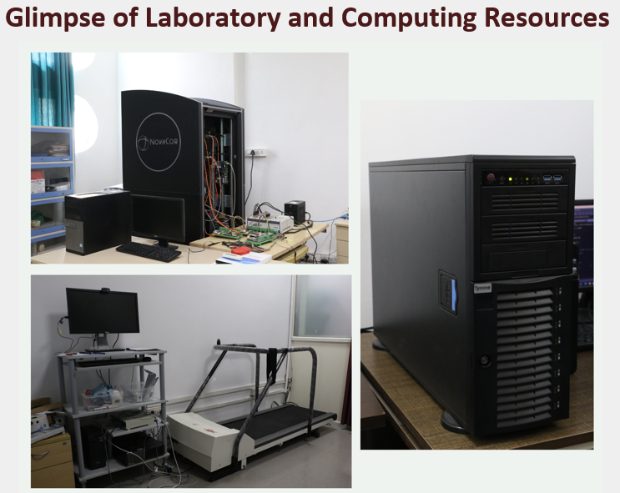
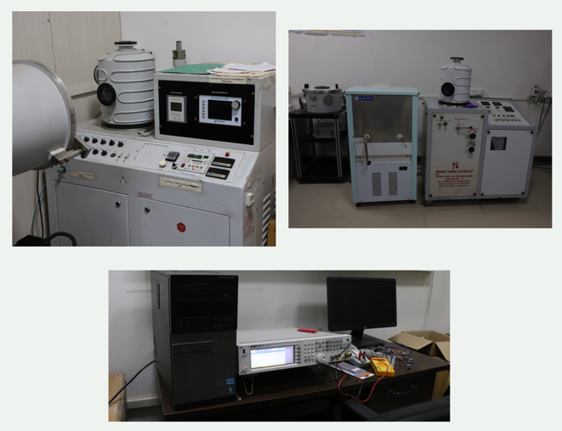
Department of Electrical Engineering IIT INDORE

Slide 25
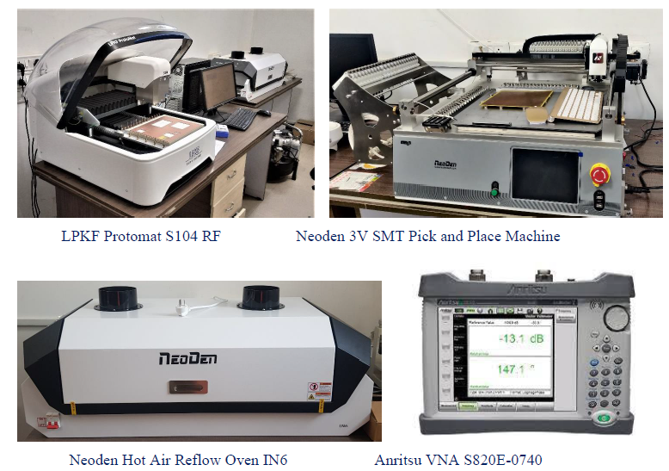
Department of Electrical Engineering IIT INDORE

Slide 26
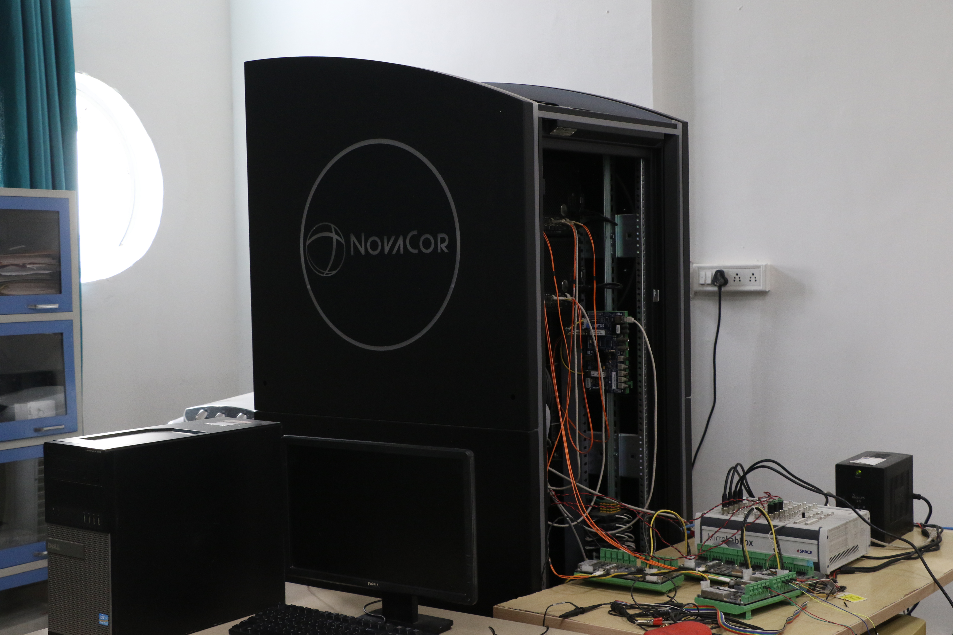
Department of Electrical Engineering IIT INDORE

Slide 27
Department of Electrical Engineering IIT INDORE

Slide 28
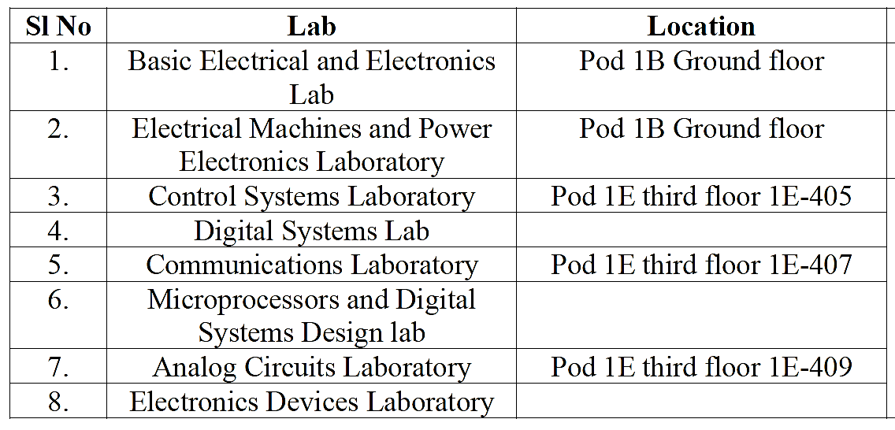
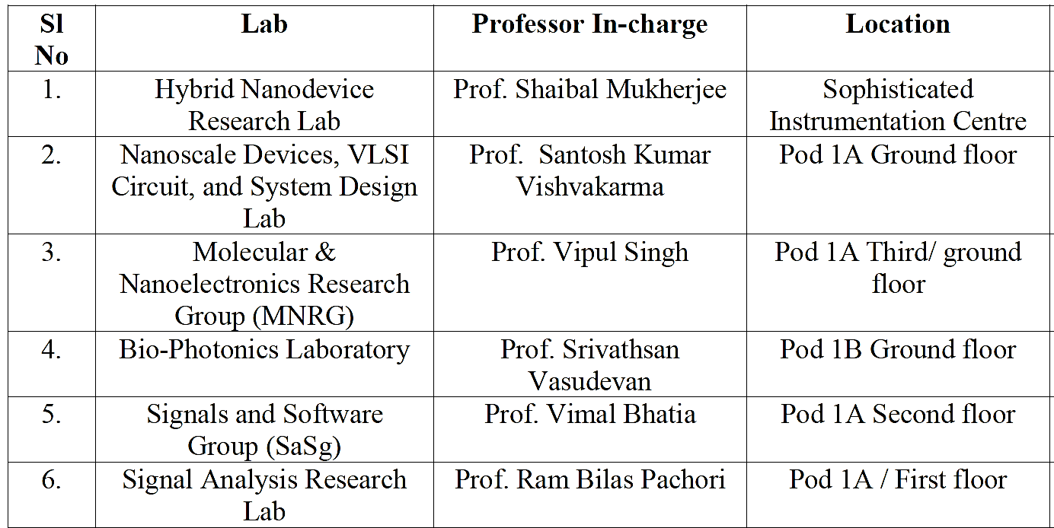
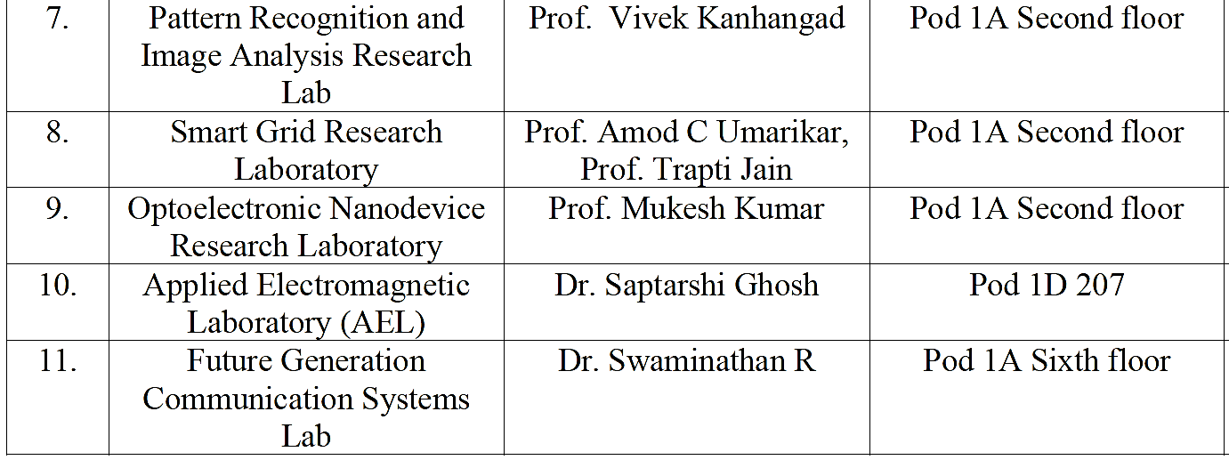
Location of Labs
Research Labs
The UG Labs
Department of Electrical Engineering IIT INDORE

Slide 29
Faculty awards
ASEM DUO-Belgium/Wallonia-Brussels mobility fellowship-2022
INAE Young Engineer Award-2022
IETE-IRSI (83) Young Scientist Award-2022
Japan Society for the Promotion of Science (JSPS)
Materials Research Society of India (MRSI) Medal-2018
IETE Technomedia Award 2018 for Young Women in Engineering
IETE-Prof SVC Aiya Memorial Award by IETE-2018, 2021.
World’s Top 2% Scientists and many more…………
Department of Electrical Engineering IIT INDORE

Slide 30
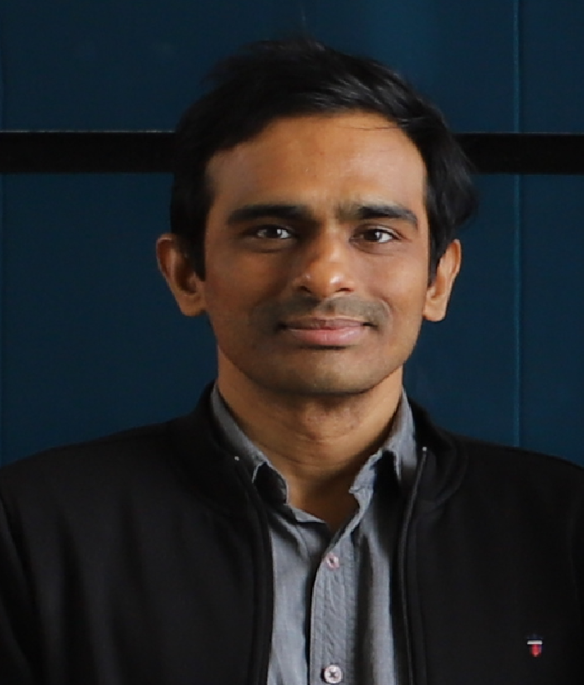
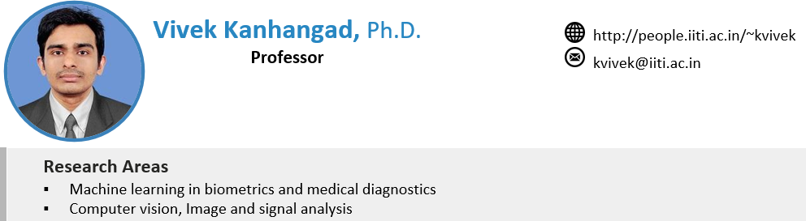

Faculty Profiles
hodee@iiti.ac.in
Head (EE)
Professor in Charge – Center for Advanced Electronics (CAE)
Department of Electrical Engineering IIT INDORE

Slide 31
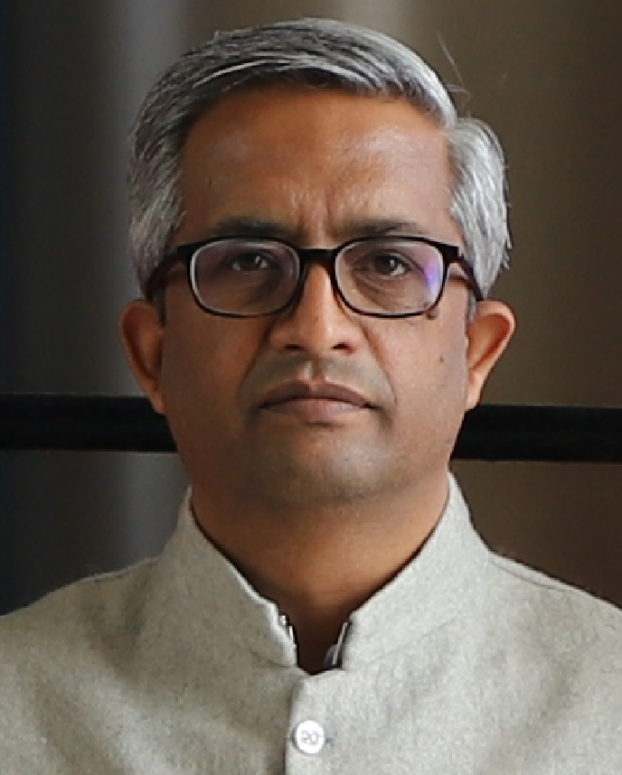
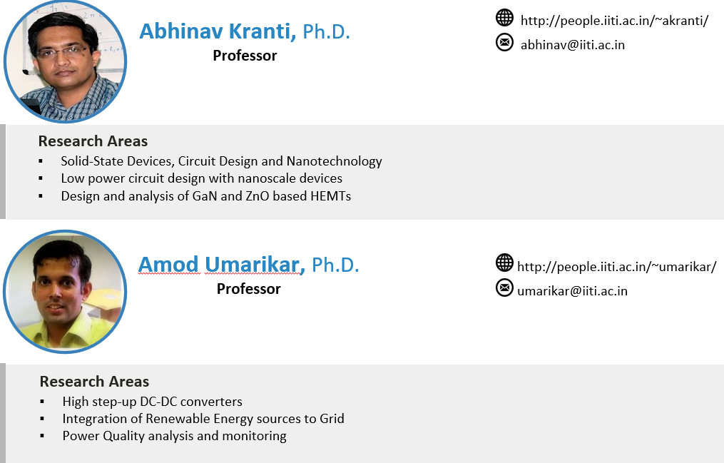
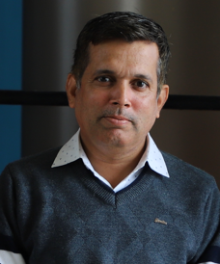
Program Coordinator: M. Tech –
VLSI Design & Nanoelectronics (VDN)
pc-vdn@iiti.ac.in
Associate Dean Faculty Affairs,
Professor in Charge – Center for Electric Vehicle and Intelligent
Transport Systems (CEVITS)
Department of Electrical Engineering IIT INDORE

Slide 32
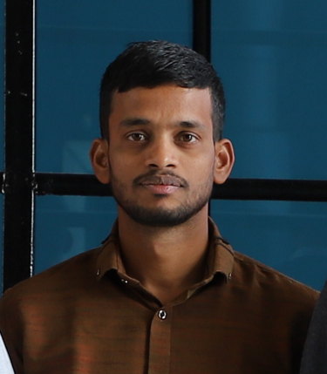
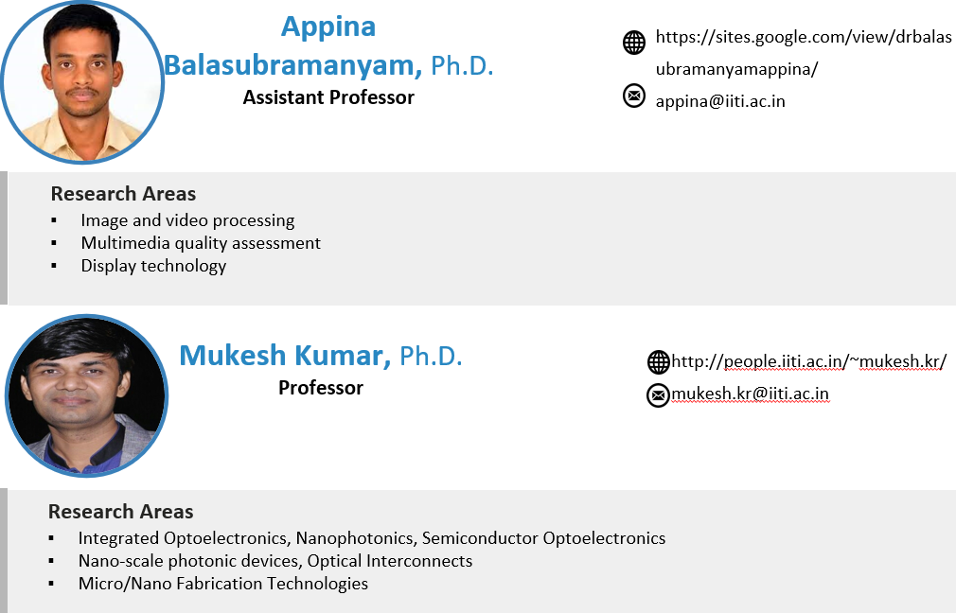
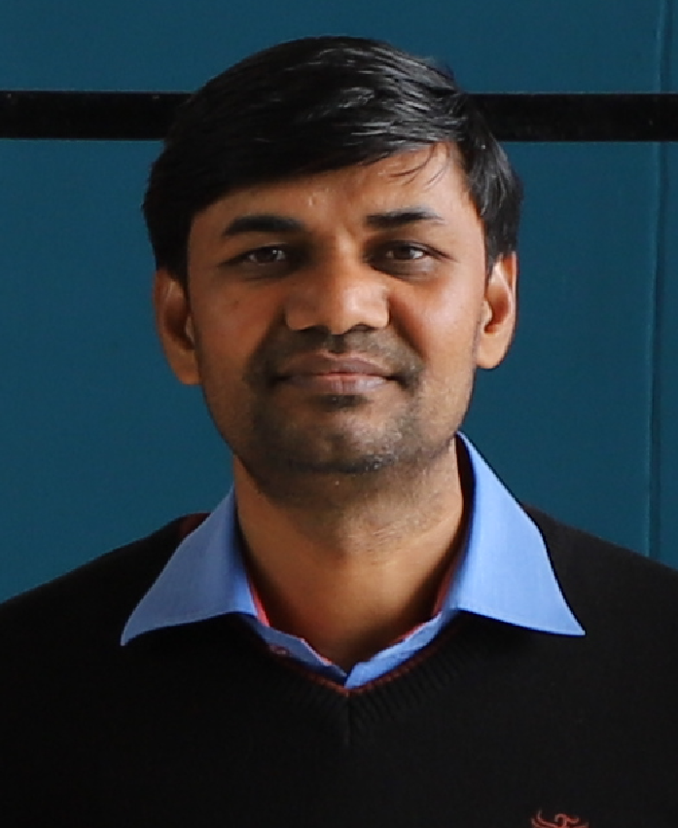
Department of Electrical Engineering IIT INDORE

Slide 33
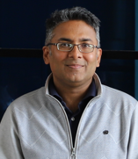
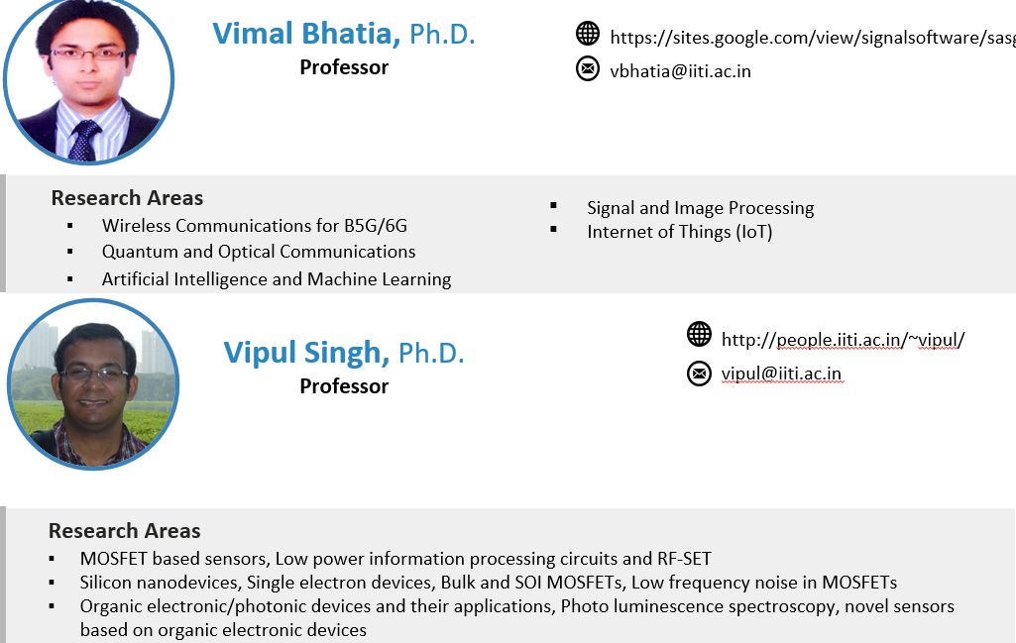
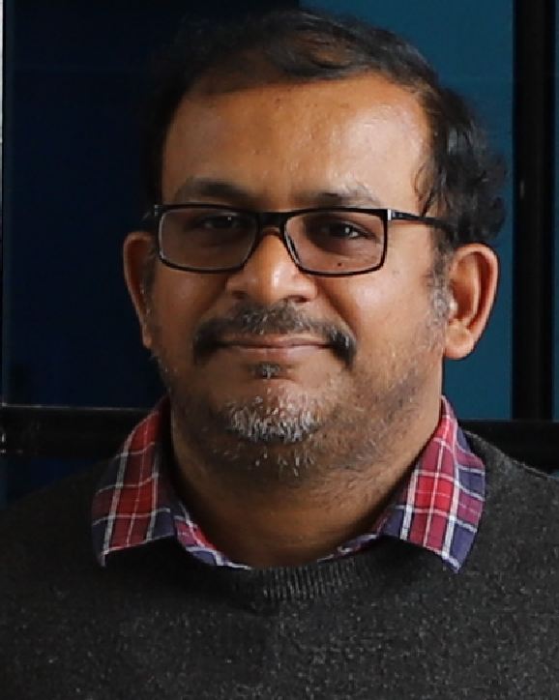
Dean Academic Affairs
doaa@iiti.ac.in
Department of Electrical Engineering IIT INDORE

Slide 34



Department of Electrical Engineering IIT INDORE

Slide 35



Department of Electrical Engineering IIT INDORE

Slide 36



Dean Student Affairs
dosa@iiti.ac.in
Department of Electrical Engineering IIT INDORE

Slide 37



Program Coordinator: M. Tech – Communications & Signal Processing (CSP)
pc-csp@iiti.ac.in
Department PG Committee (DPGC) Convenor
dpgcee@iiti.ac.in
Head Center for Entrepreneurship Education and Development (CEED)
Department of Electrical Engineering IIT INDORE

Slide 38



Associate Dean Research & Development
Program Coordinator: M.S Research
pc-msee@iiti.ac.in
Department UG Committee (DUGC) Convenor
dugcee@iiti.ac.in
Department of Electrical Engineering IIT INDORE

Slide 39



Power System Protection and Monitoring
Operational Resilience in Power Systems
Department of Electrical Engineering IIT INDORE

Slide 40
For Academic Matters
Dean Academic Affairs
Dean Student Affairs
doaa@iiti.ac.in
dosa@iiti.ac.in
Head of EE Department (HoD)
hodee@iiti.ac.in
Department UG Committee (DUGC) Convenor
dugcee@iiti.ac.in
Faculty Advisor
UG Students
Department of Electrical Engineering IIT INDORE

Slide 41


Contacts: Faculty
Department of Electrical Engineering IIT INDORE

Slide 42

Contacts: Staff
Department of Electrical Engineering IIT INDORE

Slide 43

Department of Electrical Engineering IIT INDORE

Slide 44


Department of Electrical Engineering IIT INDORE

Slide 45

Department of Electrical Engineering IIT INDORE
Starting of:
Electrical Engineering Students Association
(EESA)
16th Aug. 2023

Slide 46
Department of Electrical Engineering IIT INDORE
Unveiling of:
The New EE Department Website
16th Aug. 2023

Slide 47

Department of Electrical Engineering
IIT INDORE

Slide 48





TECH CLUBS
PROGRAMMING CLUB
SOFTWARE DEVELOPMENT
COMPETITIVE PROGRAMMING
CYBER SECURITY
progclub@iiti.ac.in
CYNAPTICS CLUB
THE AI/ML CLUB OF IIT INDORE THAT CAN HELP YOU BUILD YOUR OWN
CHATGPT OR MANY OTHER INTERESTING AI MODELS
Cynaptics@iiti.ac.in
ELECTRONICS CLUB
WORKS ON THE WIDE APPLICATIONS OF ELECTRONICS LIKE IoT,
MICROPROCESSORS, CHIPS, GENERAL ELECTRICALS AND SIMULATORS
ELECCLUB@iiti.ac.in

Slide 49



ROBOTICS CLUB
MACHINE LEARNING
ELECTRONICS
MECHANICS
CAD(COMPUTER AIDED DESIGN)
ROS(ROBOT OPERATING SYSTEM)
ROBOTICSCLUB@iiti.ac.in
IVDC CLUB
INTELLIGENT VEHICLES DESIGN AND CONTROL CLUB WORKS IN THE FIELD OF DEVELOPMENT OF AUTONOMOUS VEHICLES. IT HAS THE FOLLOWING DOMAINS
DESIGN
AUTONOMY
HARDWARE
IVDC@iiti.ac.in
GDSC
AI/ML
GAME DEV
ANDROID DEV
FULL STACK WEB DEV
BLOCKCHAIN
DSC_IIT@IITI.AC.IN

Slide 50




AEROMODELLING CLUB
WORKS IN THE FIELD OF BUILDING FLYING SMALL AIR VEHICLES AND INVOLVES THE ACTIVITY OF DESIGN, AERODYNAMICS AND DEVELOPMENT.
AEROCLUB@iiti.ac.in
CAE CLUB
THE CAE CLUB WORKS IN THE FIELD OF COMPUTER AIDED DESIGNING AND THE ENGINEERING INSPIRED FROM IT
CAECLUB@iiti.ac.in
cfa club
The club works in the following three domains
consulting
finance
analytics
Cfa@iiti.ac.in
astronomy club
A club to learn and explore about the infinite possibilities in the universe
astronomyclub@iiti.ac.in

Slide 51


concreate club
Works in the direction of creating something concrete and solid i.e. it deals with designs and engineering of buildings
concreate@iiti.ac.in
metacryst club
Works in the field of existing and new materials and also researches about the possible new material inventions
metacryst@iiti.ac.in
quantum computing club
The club attempts to solve problems that regular computers can’t in the domain like cryptography, machine learning, optimization and numerical simulations
ee220002044@iiti.ac.in

Slide 52
Club heads
Pclub- WEBD-MIHIR PATEL
CP-PV SEKHAR
CYBER SECURITY-PURAV BIYANI
2. CYNAPTICS-YATHARTH GUPTA
3. ELECTRONICS CLUB-DHRUV PARASRAMPURIA
4. ROBOTICS CLUB-akshit raizada
5. IVDC-ADITYA GUHAGARKAR
6. GDSC-ROHIT DHANOTIA
7. AEROMODELLING CLUB-soham mondal
8. CAE CLUB-JUGAL SHAH
9. CFA CLUB-TANISHA SAHU
10. ASTRONOMY CLUB-divyam,
11. CONCREATE CLUB-HIMANSHU KHATI
12. METACRYST CLUB-Aakash sangvikar
13. QUANTUM COMPUTING-kumar anmol

